Slide 1
Accelerating Systems with Programmable Logic Components Lecture 08 Verification I Basic concepts and methods of Verification
1DT109 ASPLOC
2021 VT1-VT2
Yuan Yao, yuan.yao@it.uu.se

Slide 2
Agenda
Introduction to Verification
Verification model
Verification abstraction
Verification task
Introduction to SystemVerilog
Basic building blocks
Delta delay

Slide 3



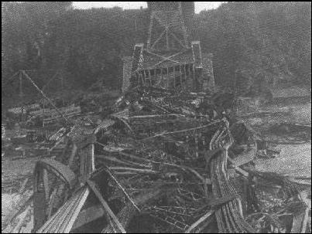
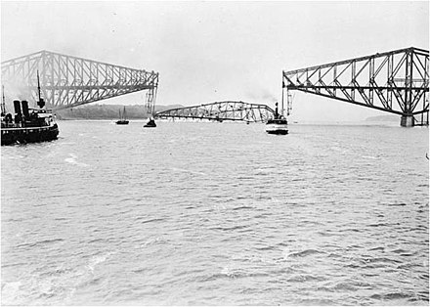
The Quebec Bridge and Pierre Laporte Bridge
Case-based testbench
Verification
Cantilever bridge
Suspension bridge
Heavy
Expensive to build
Spans shorter range
Collapse in 1907 and 1916, twice!
Due to flaws in blueprint verification
Light weight
Cheap to build
Spans longer range
Was the longest suspension bridge in the world!
Stands since 1970
Source: https://www.wikiwand.com/en/Quebec_Bridge#/google_vignette

Slide 4
The Quebec Bridge and Pierre Laporte Bridge
Case-based testbench
Verification
Case-based testbench
Verification
Verbose
Hard and tedious to build
Provide limited test cases
Waveform eyeing
Ad-hoc
Concise
Easy to build
Powerful in test strength
Coverage
Constraints
Randomization
And many more
Formal methods to verify the results
True industry standard
Source: https://www.wikiwand.com/en/Quebec_Bridge#/google_vignette

Slide 5
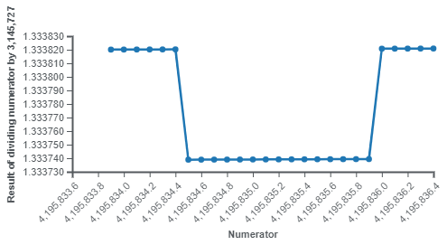
Intel’s Pentium FDIV bug
A hardware bug affecting the floating-point unit (FPU)
Discovered in 1994
Caused Intel about $ 0.5 billion to recall all flaw processors in 1995.
Roughly speaking $ 0.5 billion in 1995 is worth $ 0.9 billion today
~7.4 billion SEK
Ericsson full-year sales in 2020: ~70 billion SEK worldwide
Does this bug affect OS kernel space
such as Linux?
Source: https://en.wikipedia.org/wiki/Pentium_FDIV_bug

Slide 6


More recently – Meltdown and Spectre
A hardware bug affecting branch prediction and speculative execution in modern CPU.
Discovered in 2018
Affecting almost all modern processors:
Intel x86 microprocessors
IBM POWER processors
ARM-based microprocessors
Not on AMD processors*
Does this bug affect OS kernel space
such as Linux?
* https://en.wikipedia.org/wiki/Meltdown_(security_vulnerability)

Slide 7
Verification, validation, testing
In hardware design domain
Verification = a process in which a design is tested (or verified) against a given design specification before tape-out.
Validation = a process in which the manufactured design (chip) is tested for all functional correctness in a lab setup.
Testing = screening manufactured chips for faults or random defects, reliability, functional defects and electrical characterization before volume shipment.
Verification (this lecture)
Testing
Validation
Chip design and development life cycle
Volume shipment
Specifications
Architecture
Microarchitecture
RTL Design
Physical Design
Tapeout
Prototype
(Chip back from fab)

Slide 8
The Embedded SoC engineering pie

Slide 9
What to verify – the reconvergence model
Requirements
Remember that the purpose of the verification process is to ensure that the functionality of a logic is as intended.
The reconvergence model is a conceptual representation of what to verify.
System design team’s interpretation
(SystemC)
Independence of interpretation by design and verification teams is expensive but essential.
Specification
Verification Team’s Interpretation
(SystemVerilog)
Design Team’s Interpretation
(Verilog)
Do not fight.
Implementation

Slide 10
Verification models
Black-box model
The verification team has access to input and output only
White-box model
The verification team has access to the internal logic
Grey-box model
The verification team has access to the internal logic that is specifically designed to aid debug

Slide 11
Verification abstraction
Function/system level
Operations ordered by functionality
Example: DSP systems modeled in Matlab
Transaction level
Operations ordered by transmission protocol
Example: AXI data transfer
RTL/cycle accurate level
Operations ordered by clock signal
Example: FSM state transition
Gate/Transistor level
Operations ordered by physical signal
Example: Bit change in gate with manufactural delays
Higher abstraction level = greater efficiency but less control
We mainly focus here

Slide 12
Verification tasks
In each of the verification hierarchy, checking the following
Function and performance
Function: A piece of HW/SW that transforms input to output
Performance: How well does the function perform in terms of figures of merits
Timing and interface
The logic timing which specifies when the input and output should appear/be valid/be active, especially in relation to each other.
Address/Location/Amount
The amount of data that is read/input and the location from which it is read.
The amount of data that is written/output and the location to which it is written.
Structure/configuration
IPs/Sub-systems are connected and configured properly

Slide 13
The verification space
Model
Abstraction
Task

Slide 14
Why SystemVerilog
Verilog lacks
Constrained random generation
Functional coverage
Assertions
Specman E/Vera
Used with VHDL and Verilog for constrained random generation and functional coverage
Property specification language (PSL)
For assertion
Learning 1 language (SystemVerilog) is better than learning 2 (Specman E/Vera and PSL)
Even as a verification engineer, one should have enough knowledge on HDL and system design language such as SystemC

Slide 15
More than just a verification tool
SystemVerilog rapidly getting accepted as the next generation HDL for
System design
RTL design and synthesis
Verification
Easy bridging up different design teams.
It is strongly practiced by the industries such as Ericsson.
There are many properties and features in SV (can be enough for another full course).
We will only cover a small set of useful ones for writing testbench in this course.
In this course, we use Verilog for RTL modeling and SV only for verification.

Slide 16
Basic building blocks
Basic data types
Different always blocks
Struct vs. Class
Packed and unpacked array
Associative array
File

Slide 17
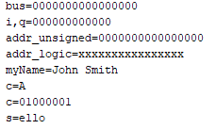
Basic data types
bit [15:0] bus; //unsigned
bit signed [11:0] i, q; // signed
shortint unsigned addr_unsigned;
logic [15:0] addr_logic;
string myName = “John Smith”;
byte c = “A”; // assign c “A”
bit [3:0][7:0] s = “hello”; // assign s “ello”
$display("bus=%b", bus);
$display("i,q=%b", i);
$display("addr_unsigned=%b", addr_unsigned);
$display("addr_logic=%b", addr_logic);
$display("myName=%s", myName);
$display("c=%c", c);
$display("c=%b", c);
$display("s=%s", s);
//demo_1
2 valued data type
bit: 1 bit
byte: 8 bit (char), signed
shortint: 16 bit, signed
int: 32 bit, signed
4 valued data types
reg/wire: 1 bit
logic: 1 bit, identical to reg
integer: 32 bit, signed
Choose the proper data type to use in the testbench.

Slide 18
Different always blocks
Comes in four flavors
always
The old Verilog legacy.
always_ff
Clocked synchronous body
To infer DFF
The only case to use “<=”
always _comb:
To infer combinational logic
Sensitivity list is inferred from signals involved in the RHS of expressions.
always_latch
To infer latch
Sensitivity list is inferred from signals involved in the RHS of expressions.
module demo_2(
input a,
input b,
output c
);
reg c;
always_ff
if (b)
c <= a;
endmodule
module demo_2(
input a,
input b,
output c
);
reg c;
always_comb
if (b)
c = a;
endmodule
module demo_2(
input a,
input b,
output c
);
reg c;
always_latch
if (b)
c = a;
endmodule
Can be used for synthesis.
always_ff @ (a, b)
if (b)
c <= a;
Warning.
No DFF generated.
Compilation error.
Warning.
No comb logic generated
Correct.

Slide 19
Struct vs. Class
Both are used to represent information composed of different types.
The example struct models IEEE single-precision floating-point number.
The example class models ATM info packet which is fixed 4-byte of user data.
typedef struct {
bit sign;
bit [22:0] mantissa;
bit [ 7:0] exponent;
} ieee_sp_float;
class atm_pkt;
bit [11:0] id;
bit [15:0] pw;
bit [ 3:0] pri;
endclass: atm_ pkt
Pay attention to the difference of the semi-colon at the end

Slide 20
Concept of struct
A struct is an integral type, just like integer or reg.
Whenever a “struct” type is declared, the necessary number of bits is automatically allocated.
If a struct variable is assigned to another or passed as an argument to a function or task, all the bits are copied.
typedef struct {
bit sign;
bit [22:0] mantissa;
bit [ 7:0] exponent;
} ieee_sp_float_unpacked

Slide 21
Concept of struct
If a struct is declared packed, the bits of the struct fields are laid out consecutively in memory.
We can thus define literal value for a struct.
This allows the struct to be seamlessly converted to and from bit vectors.
typedef struct packed {
bit sign;
bit [22:0] mantissa;
bit [ 7:0] exponent;
} ieee_sp_float_packed
Sign
Mantissa
Exponent
31
30 6
5 0

Slide 22

More on struct
module demo_3;
function ieee_sp_float_packed abs (ieee_sp_float_packed v);
v.sign = 0;
abs = v;
endfunction: abs
initial begin
ieee_sp_float_packed v1, v2;
ieee_sp_float_unpacked v3;
v1 = {1'b1, 23'hf00000, 8'h0};
v2 = v1;
v1 = abs(v1);
$display("v1 = %b, %b, %b", v1.sign, v1.mantissa, v1.exponent);
$display("v1 = %b, %b, %b", v1[31], v1[30:8], v1[7:0]);
$display("v2 = %b, %b, %b", v2[31], v2[30:8], v2[7:0]);
v3 = {1'b1, 23'hf00000, 8'h0};
$display("v3 = %b, %b, %b", v3.sign, v3.mantissa, v3.exponent);
$display("v3 = %b, %b, %b", v3[31], v3[30:6], v3[5:0]);
end
endmodule
Concatenation assignment to unpacked struct leads to warning.
Bit selection on unpacked struct leads to compilation error.
Warning
Error

Slide 23
Concept of class
Variable
By default, “public”
To use private var:
local bit [11:0] id
class atm_pkt;
bit [11:0] id;
bit [15:0] pw;
bit [ 2:0] pri;
function new (bit [11:0] id = 12’hfff,
bit [15:0] pw = 16’hffff);
this.id = id;
this.pw = pw;
this.pri = 3’b0;
endfunction
function atm_pkt copy ();
copy = new;
copy.id = this.id;
copy.pw = this.pw;
copy.pri = this.pri;
endfunction: copy
function display ();
$display (“ id = 0x%0h,
pw=0x%0h,
pri=%0b",
this.id, this.pw, this.pri);
endfunction
endclass: atm_pkt
In object-oriented programming (OOP), a class is a structure that encapsulates variables and functions that process the variables.
Some of the functions are pre-defined implicitly but can be override by user explicitly.
All other functions should be defined explicitly by user.
Overridden constructor new
Call the overridden new constructor
Self-defined function
Self-defined function

Slide 24

Instantiation of class using new
module demo_4;
initial begin
atm_pkt u1, u2;
u1 = new;
u2 = new (12'h123, 16'h1234);
u1.display();
u2.display();
end
endmodule
class atm_pkt;
bit [11:0] id;
bit [15:0] pw;
bit [ 2:0] pri;
function new (bit [11:0] id = 12’hfff,
bit [15:0] pw = 16’hffff);
this.id = id;
this.pw = pw;
this.pri = 3’b0;
endfunction
. . .
function display ();
$display (“ id = 0x%0h,
pw=0x%0h,
pri=%0b",
this.id, this.pw, this.pri);
endfunction
endclass: atm_pkt
Output from Vivado

Slide 25

More on class
class atm_pkt;
...
function new (bit [11:0] id = 12’hfff,
bit [15:0] pw = 16’hffff);
this.id = id;
this.pw = pw;
this.pri = 3’b0;
endfunction
function atm_pkt copy ();
copy = new;
copy.id = this.id;
copy.pw = this.pw;
copy.pri = this.pri;
endfunction: copy
…
endclass: atm_pkt
module demo_4
Initial begin
atm_pkt u1, u2, u3; // object instantiation
u1 = new;
u1.id = 12’h123;
u2 = u1; // u1 & u2 refer to same
// instance
u3 = u2.copy(); // u2 & u3 differ
// but have same content
u2.id = 12’h456; // only u1 and u2 will // change
end
A class is a dynamic type.
Whenever a class type is declared (using the new keyword), only a null pointer to a new instance of the class is created.
All info of the instance must be explicitly allocated.
If a class variable is assigned to another or passed as an argument to a function or task, only the pointer is copied into another class instance.

Slide 26
Difference between struct & class
A class can be converted to and from bit vectors by using user defined packing and unpacking functions.
The biggest difference between struct and class is that the class is the only type in SystemVerilog that supports the object-oriented programming model.
Encapsulation
Inheritance
Polymorphism
Use struct for writing synthesizable design.
Packed struct is very similar to bit-vectors
Use class when writing testbenches.
Learn at least one OOP language.
C++/Python/SystemC

Slide 27
Packed and unpacked array
Packed arrays can only be made of single-bit types and their dimensions are specified to the left of the variable name.
Packed arrays are implemented as consecutive bits and can be implicitly used as signed or unsigned integer values.
Unpacked arrays can be of any type.
They are declared with their dimensions specified to the right of the variable name.
Each element of an unpacked array is an individual value.
bit [ 7:0] a_byte;
logic [ 3:0] [ 7:0] q_quadword;
ieee_sp_float [31:0] scoreboard; // INVALID
bit eight_bits[8];
logic sixteen_bits[4][4];
ieee_sp_float scoreboard[32]; // VALID

Slide 28
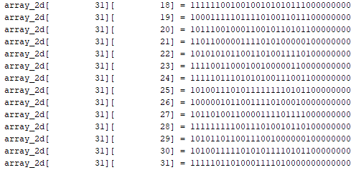
More on unpacked array
Which should be used to model a general-purpose array?
Packed or unpacked?
A dynamic array is an unpacked array with an unspecified dimension size.
The actual size of the array is specified and allocated at runtime.
1-D or multi-dimensional.
ieee_sp_float_packed array_1d [ ]; //demo_5
array_1d = new [32]; // 32 elements
array_1d = new [64] (array_1d); // resize
array_1d.delete(); // Delete array
ieee_sp_float_packed array_2d [ ][ ];
bit [22:0] rand_vec;
array_2d = new [32];
foreach (array_2d [i])
array_2d[i] = new [32];
foreach (array_2d [i, j])
rand_vec = $urandom();
array_2d[i][j] = {1'b1, rand_vec, 8'h0};
Observe how the array_2d is indexed.
No need to declare I,j
Call the SV operator new to allocate memory for the array dynamically.
Not a constructor!

Slide 29
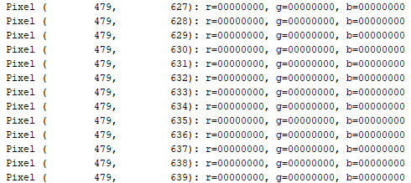
Multi-dimensional dynamic array of class
class pixel;
bit [7:0] red;
bit [7:0] green;
bit [7:0] blue;
endclass: pixel
/*******************************/
class line;
pixel pixels[];
function new (input int unsigned n);
this.pixels = new[n];
endfunction: new
endclass: line
/*******************************/
class picture;
line lines[];
function new (input int unsigned x,y);
this.lines = new [x];
foreach (this.lines[i]) begin
this.lines[i] = new(y);
end
endfunction: new
endclass: picture
Multi-dimensional dynamic arrays can be emulated by using a dynamic array of classes containing a dynamic array.
Since this multi-dimensional array is composed of independent one-dimensional arrays, the size and number of each dimension can vary.
Problem?
foreach (this.pixels[i])
this.pixels[i] = new();
Need to call new()!
Otherwise, only nulls exist in pixels
module demo_3;
initial begin
picture vga = new(480, 640);
pixel center = vga.lines[240].pixels[320];
end
endmodule

Slide 30
Associative array
Associative arrays are used for non-ordinal or non-consecutive indexing operations.
The elements in an associative array are not considered ordered from index 0 through index N-1.
They are randomly stored based on an efficient indexing mechanism that can use any type — even a string or class reference — as indexing value.
The concept is close to the “map” data structure
One of the best applications of an associative array is to model a large memory.
16GB
0
Allocated region

Slide 31
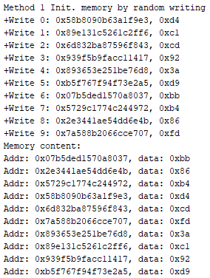
More on associative array
class sparse_memory;
local logic [7:0] mem [bit [63:0]];
/********************************/
function logic [7:0] read(input bit [63:0] addr);
read = 8’hxx;
if (this.mem.exists(addr)) begin
read = this.mem[addr];
end
endfunction: read
/********************************/
function void write(input bit [63:0] addr,
input logic [ 7:0] data);
this.mem[addr] = data;
endfunction: write
/********************************/
function void display();
foreach (mem[i])
$display("Addr: 0x%h, data: 0x%h", i, mem[i]);
endfunction: display
endclass: sparse_memory
module demo_7;
sparse_memory mem = new();
bit [63:0] addr;
bit [7:0] data;
initial begin
$display(“Method 1 Init. memory by random writing”);
repeat (10) begin
addr = { $urandom(), $urandom() };
data = $urandom();
mem.write(addr, data);
$display("0x%h, 0x%h", addr, mem.read(addr));
end
mem.display();
end
endmodule
$random()/$urandom() only return 32-bit random number

Slide 32
File
SystemVerilog can both open file for read and write using the $fopen() system task.
The task will return a 32-bit integer handle called a file descriptor. This handle should be used to read and write to the file until closed.
Close a file by using the $fclose() system task.
File is another way to initialization memory content.

Slide 33
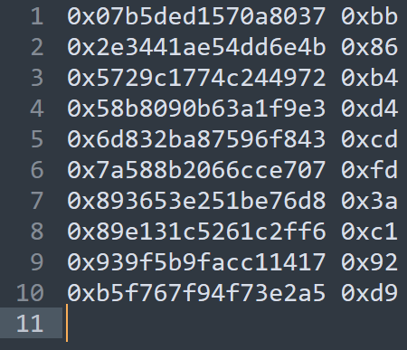
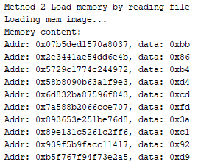
More on File
class sparse_memory; // demo_7
local logic [7:0] mem [bit [63:0]];
/********************************/
function void loadimage();
$display("Loading mem image...");
fd = $fopen("mem_image.txt", "r");
if (fd) begin
while (!$feof(fd)) begin
bit [63:0] addr;
bit [7:0] data;
string line;
$fgets(line, fd);
$sscanf(line, "%h %h", addr, data);
this.write(addr, data);
end
$fclose(fd);
end else
$display("Error in opening memory image file.");
endfunction: loadimage
endclass: sparse_memory
File content
Remember to import the file to Vivado as “Simulation Sources”
module demo_7;
sparse_memory mem = new();
bit [63:0] addr;
bit [7:0] data;
initial begin
$display(“Method 2 Load memory by reading file”);
mem.loadimage();
mem.display();
end
endmodule

Slide 34

Questions?

